Slide 1


Slide 2

Content
Classification of numbers.
Divisibility rules.
Factorials.
Unit digit calculation.
Number of Factors
Remainder Theorems
HCF and LCM

Slide 3
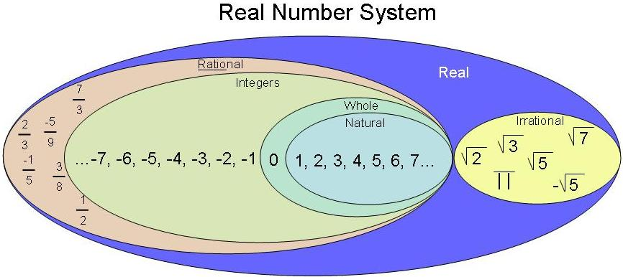
Types of numbers

Slide 4
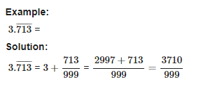
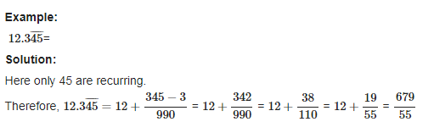
Conversion of a decimal number to fraction:

Slide 5
Question. Find the rational form of the recurring rational 0.5333333333
[A] 11/99
[B] 1/3
[C] 8/15
[D] 13/30

Slide 6
Question. Convert 37.565656565656……………. into P/Q
A)3719/99 B)3663/90 C)3443/990 D)None of these

Slide 7
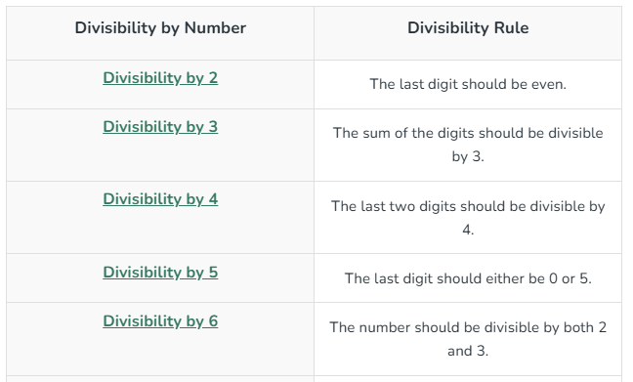
Divisibility Rules

Slide 8
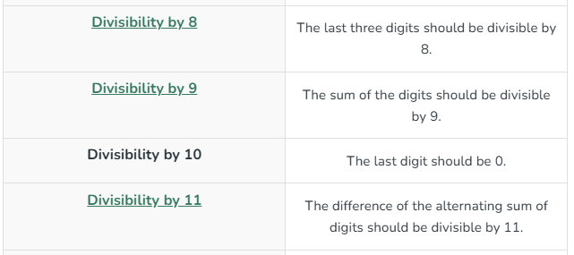

Slide 9
Question: If number 259292N is divisible by 2. How many values N can take?
[A] 4
[B] 5
[C] 3
[D] 6

Slide 10
Question: What should come in place of N if 545K5 is divisible by 9?
[A] 7
[B] 8
[C] 9
[D] 2

Slide 11
Question: For what values of P number 36345472P34 is exactly divisible by 9.
[A] 3
[B] 4
[C] 6
[D] 7

Slide 12
Question: For what values of N number 549724N is exactly divisible by 6.
[A] 2 & 8
[B] 4 & 6
[C] 2 & 6
[D] 6 & 8

Slide 13
Question: For what values of K number 99857K32 is exactly divisible by 11.
[A] 1
[B] 0
[C] 3
[D] 4

Slide 14
Question: What should come in place K if 4857K is divisible by 88?
[A] 6
[B] 8
[C] 2
[D] 4
[E] None of these

Slide 15
Factorials Trailing zeros (Number of zeros at the end)
Concept: In multiplication zero can be produced when we have a pair of 2 and 5. So, in order to find no. of zeros at the end, the pair of 2 and 5 need to be counted.
Example: 2^3 x 5 x 9 x 8 x 24 x 15 Find number of zeros at the end.

Slide 16
Question: Find number of trailing zeros in 50!
[A] 12
[B] 10
[C] 15
[D] 27

Slide 17
Question: Find number of trailing zeros in 154!
[A] 35
[B] 31
[C] 34
[D] 37

Slide 18
Question: Find number of trailing zero in 100!+200!+300!
[A] 24
[B] 49
[C] 73
[D] None of these

Slide 19
Question: Find number of trailing zero in 100! X 200!
[A] 24
[B] 49
[C] 73
[D] None of these

Slide 20
Unit Digits:
Right most digit of a number is called Unit digit.
For e.g. 278 × 623 what will be the unit digit?
8 x 3 = 24 The last digit is 4

Slide 21
Unit Digit of higher power numbers

Slide 22
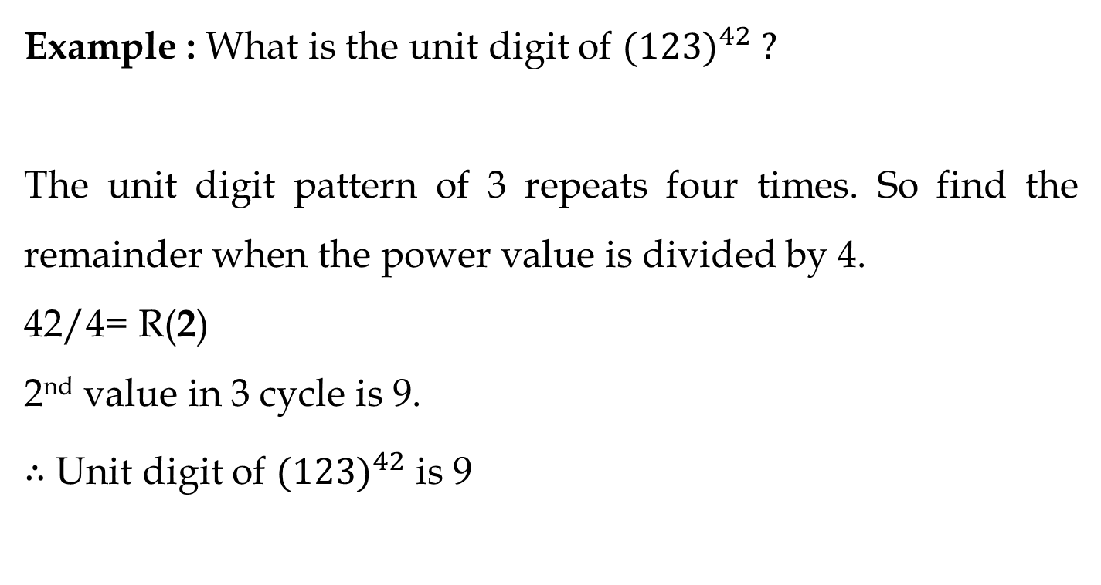

Slide 23
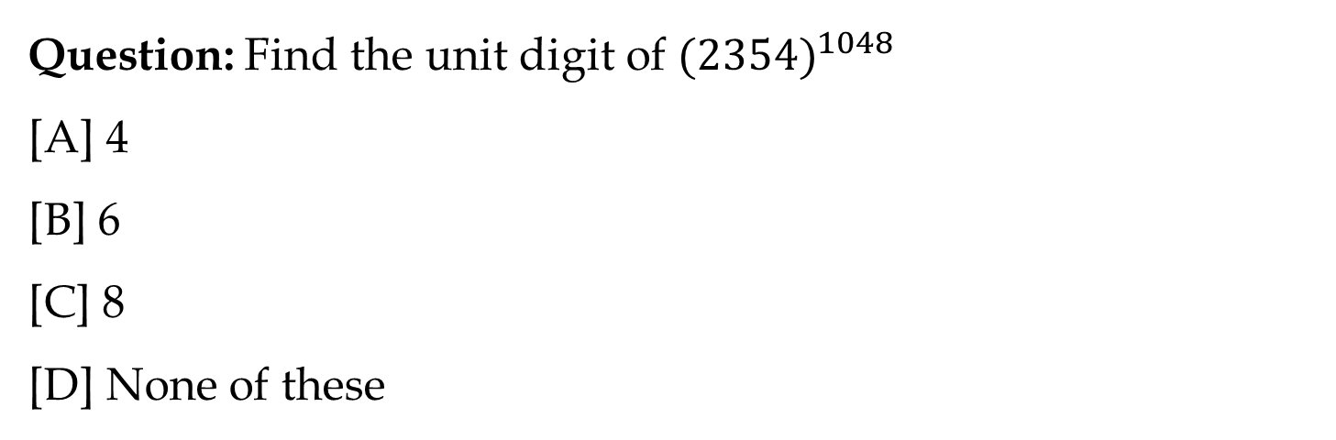

Slide 24
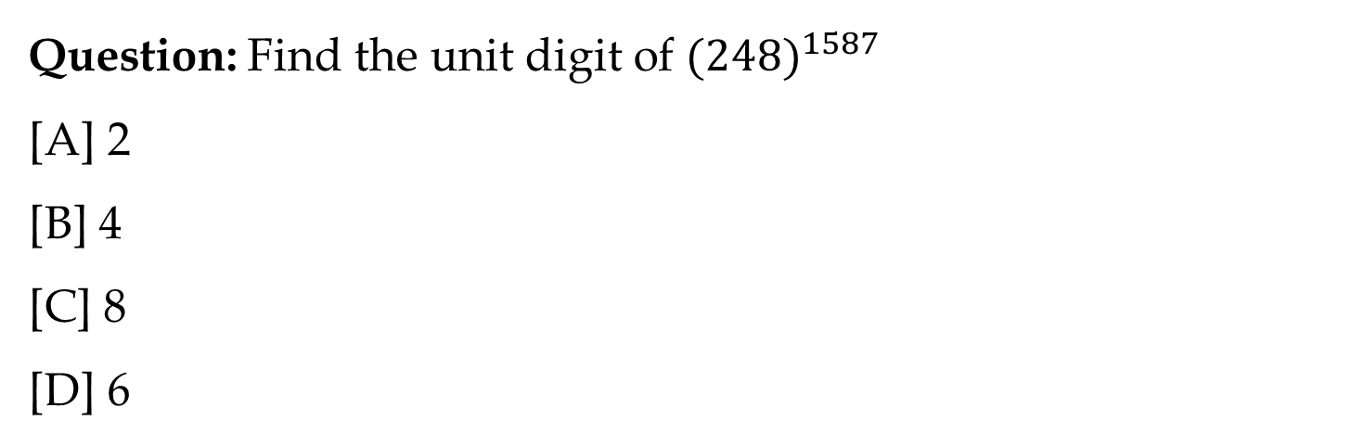

Slide 25
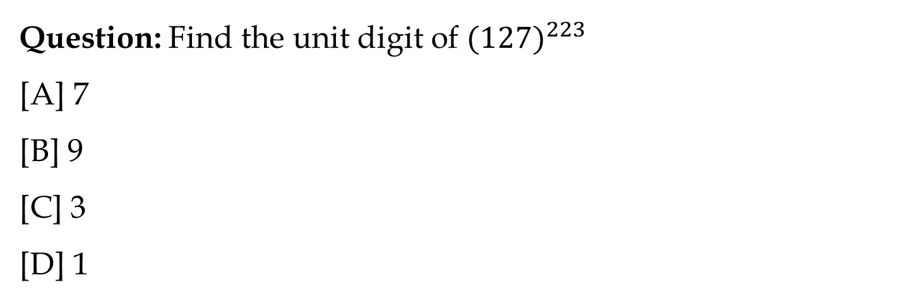

Slide 26
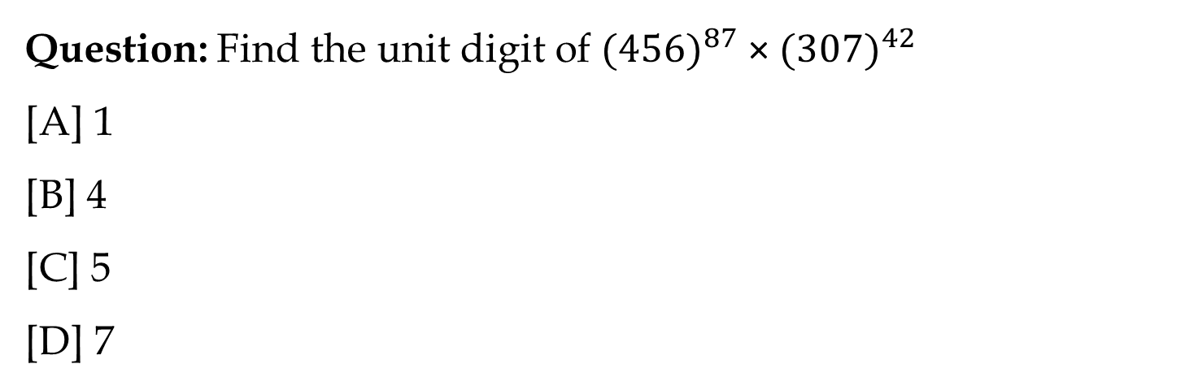

Slide 27
Number of Factors
Factors of a number are the values that divides the number completely.
Example: Factors of 10 are 1, 2, 5 and 10.

Slide 28
Total Number of factors:
Take any number “N” and it is to be convert into product of prime numbers (Prime factorization) i.e.
N = A^{p} x B^{q} x C^{r} here A, B , C are prime numbers and p, q, and r were respective powers of that prime numbers.
Total numbers of factors for N = (p + 1)(q +1)(r +1).

Slide 29
Example: 1200
Step 1: Prime factorize the given number
1200 = 12 x 100
= 2^2 x 3 x 10^2
= 2^2 x 3 x 2^2 x 5^2
= 2^4 x 3 x 5^2
Step 2: Add 1 to the powers and multiply.
(4+1) x (1+1) x (2+1)
= 5 x 2 x 3
= 30
∴ Number of factors of 1200 is 30.

Slide 30
Question: Find the total number of factors of 230.
[A] 2
[B] 8
[C] 16
[D] 32

Slide 31
Question: Find the total number of factors of 1560.
[A] 6
[B] 16
[C] 12
[D] 32

Slide 32
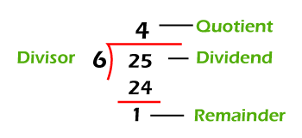
Remainder theorem
Dividend= (Divisor × Quotient + remainder)

Slide 33
Question: In a division process divisor is 5 times of quotient and remainder is 3 times of quotient. If remainder is 15. Find dividend.
[A] 140
[B] 150
[C] 170
[D] 190

Slide 34
Question: A number when divided by 252 leaves the remainder 34. Find the remainder when the same number is divided by 21.
[A] 13
[B] 5
[C] 7
[D] 2

Slide 35
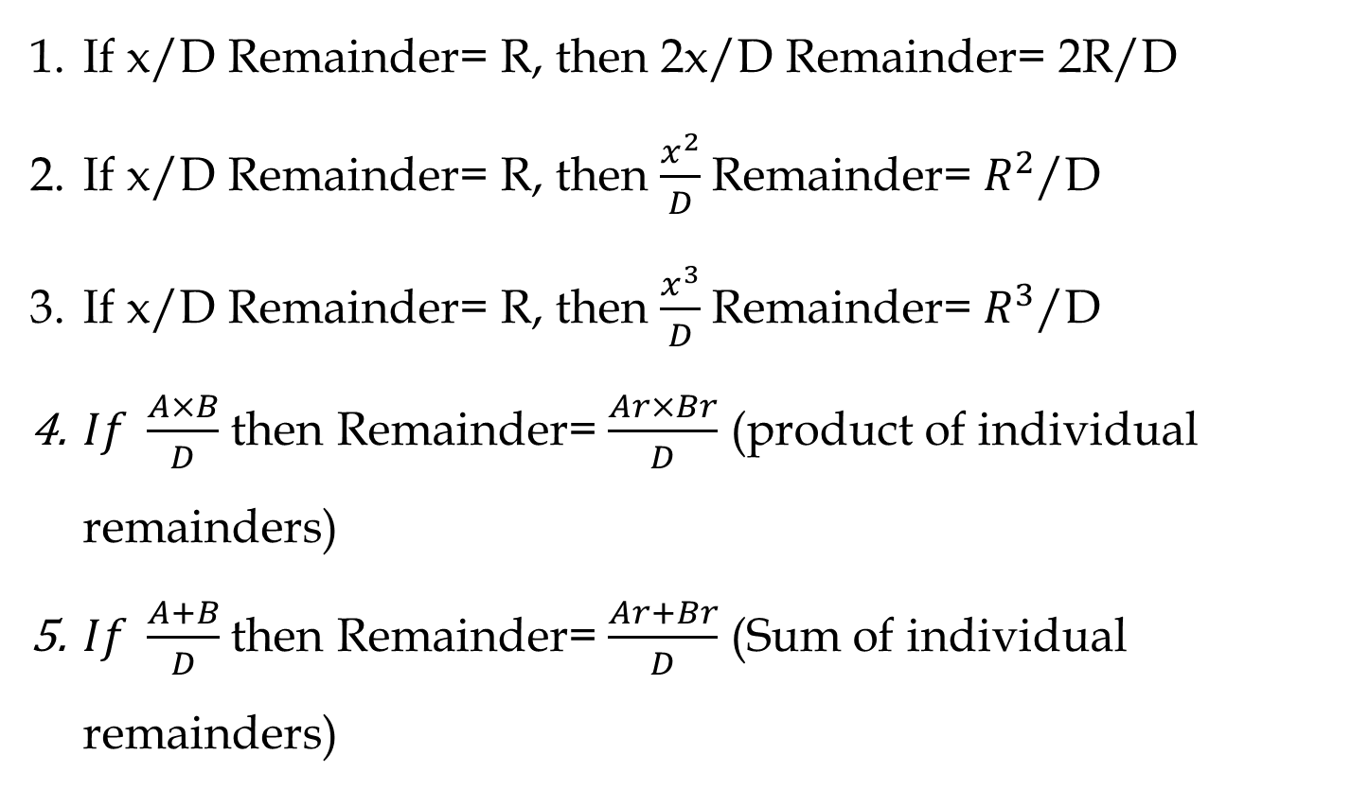
Important Rules

Slide 36
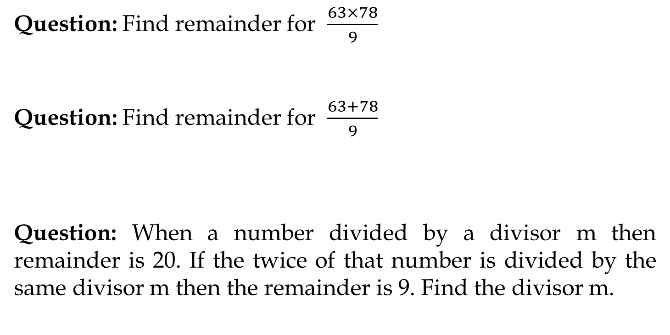

Slide 37
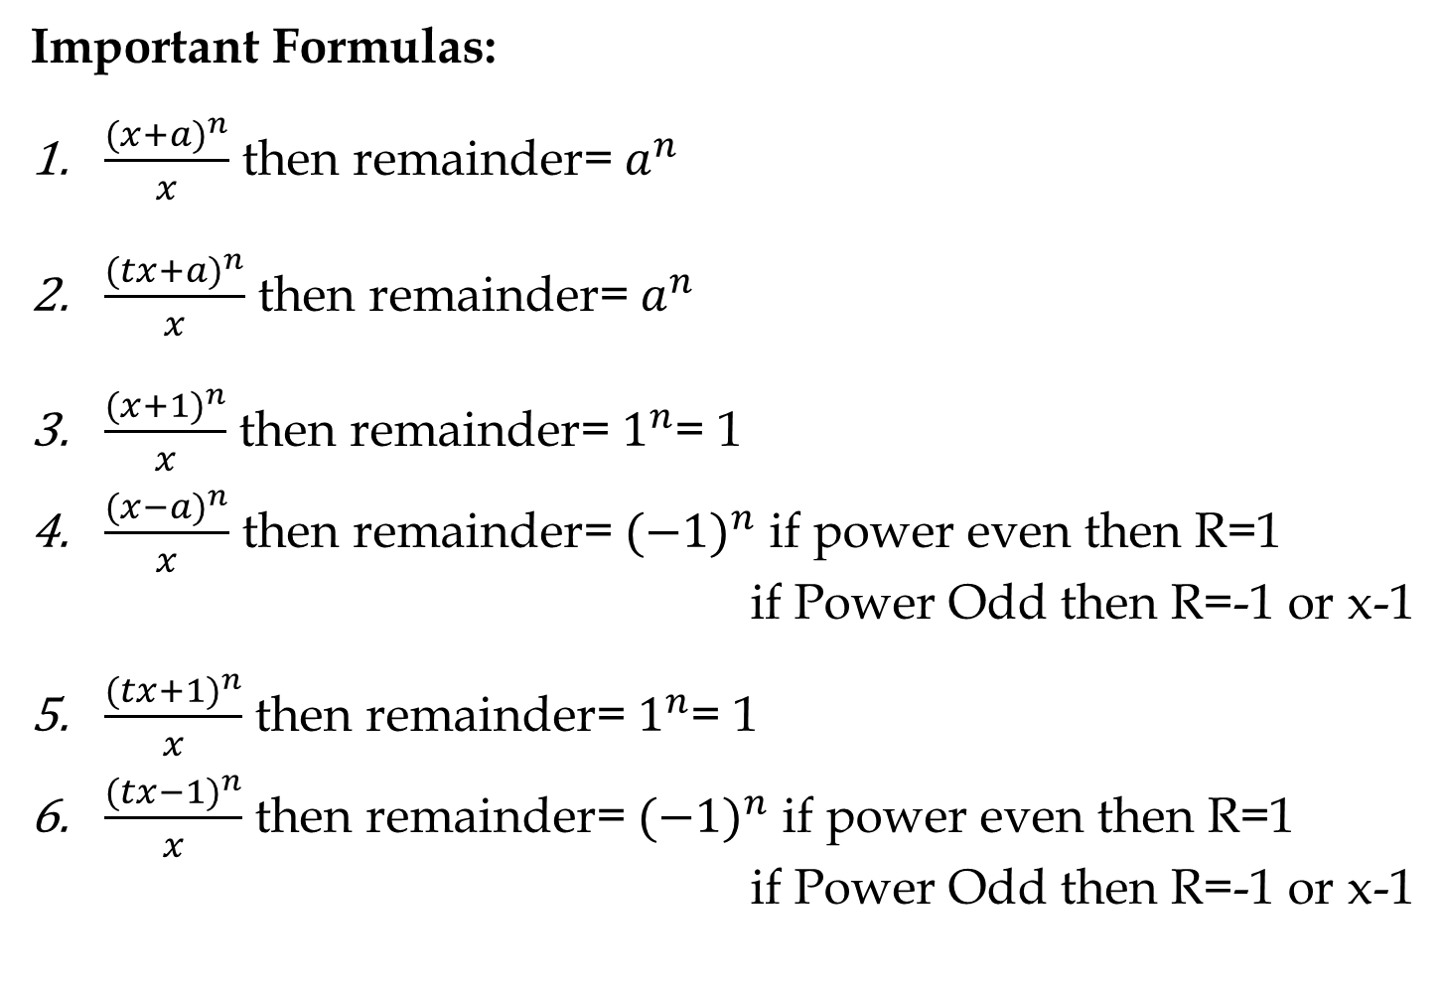

Slide 38
Remainder Cyclicity:
Example: What is the remainder when 2^201 is divided by 7?
2^1/7 = R(2)
2^2/7= R(4)
2^3/7 = R(1) or 8/7 = R(1)
Therefore [(2^3)^67 ] / 7 = 1 / 7
1/7 = R(1)

Slide 39
Note: Do not cancel any numerator value with the denominator value as the remainder will differ.
R(6/4) ≠ R(3/2)
6/4 = R(2)
But 3/2 = R(1)
If you want to cancel out numerator and denominator by a certain value then at last we also need to multiply the remainder by the same value in order to get correct remainder.

Slide 40
Q) What is the remainder when 2⁷ is divided by 8?
[A] 0
[B] 4
[C] 5
[D] 7

Slide 41
Q) Remainder when 35¹¹³ is divided by 9?
[A] 1
[B] 8
[C] 3
[D] 4

Slide 42
Q) Remainder when 2⁴⁵ is divided by 9?
[A] 1
[B] 4
[C] 8
[D] 5

Slide 43
Q) Remainder when 2⁹⁹ is divided by 10?
[A] 1
[B] 4
[C] 2
[D] 8

Slide 44
LCM & HCF
LCM- Least Common Multiple
For e.g. 12= 12, 24, 36, 48, 60, 72, 84, 96…………
16= 16, 32, 48, 64, 80, 96…………
So there are lots of multiple of 12 and 16 which will be common but the least multiple which is common is 48.
So LCM = 48

Slide 45
HCF- Highest Common Factor
For e.g. 12= 1, 2, 3, 4, 6, 12
16= 1, 2, 4, 8, 16
So there three common factor=1, 2, 4 but the Greatest factor is 4. That is the HCF of 12 and 16.

Slide 46
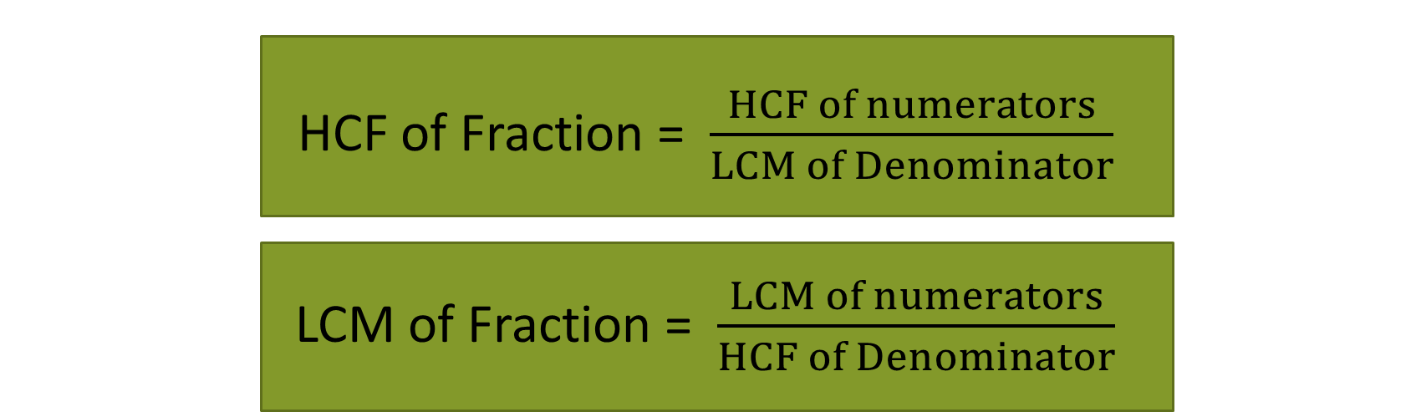
Important Formulae
Product of Two numbers = HCF x LCM

Slide 47
LCM Word Problems
Question | Answer
The Least number which is exactly divisible by x, y and z | LCM(x, y, z)
The least number which when divided by x, y, z leaves the same remainder R in each case | LCM (x, y, z) + R
The least Number which when divided by x, y and z, leaves remainder a, b and c respectively | LCM (x, y, z)-K Where K=(x-a)=(y-b)=(z-c)

Slide 48
HCF Word Problems
Question | Answer
The greatest number that will exactly divide x, y and z | HCF(x, y, z)
The greatest number that will divide x, y, z and leaves remainder R in each case | HCF(x-y, y-z, z-x) OR HCF(x-R, y-R, z-R)
The greatest Number that will divide x, y and z, leaving remainder a, b and c respectively | HCF(x-a, y-b, z-c)

Slide 49
Q) Find the lowest common multiple of 24, 36 and 40.
[A] 120
[B] 240
[C] 360
[D] 480

Slide 50
Q) The greatest number that will exactly divide 36 and 84 is:
[A] 4
[B] 6
[C] 12
[D] 18

Slide 51
Q) Four bells ring at an interval 3min, 4min, 5min and 6 minutes respectively. If all the four bells ring at 9am first, when will it ring again?
A]. 10:00am
B]. 10:30am
C]. 11:00am
D]. None of these

Slide 52
Q) Which of the following fraction is the largest? 7/8, 13/16, 31/40, 63/80
[A] 7/8
[B] 13/16
[C] 31/40
[D] 63/80

Slide 53
Q) Three number are in the ratio of 3 : 4 : 5 and their L.C.M. is 2400. Their H.C.F. is:
[A] 40
[B] 80
[C] 120
[D] 200

Slide 54
Q) Find the smallest number, which when divided by 3, 4 and 5 leaves remainder 1, 2 and 3 respectively?
[A] 60
[B] 53
[C] 58
[D] None

Slide 55
Q) The greatest number which on dividing 1657 and 2037 leaves remainders 6 and 5 respectively, is:
[A] 123
[B] 127
[C] 235
[D] 305

Slide 56
Q) Find the greatest number that will divide 43, 91 and 183 so as to leave the same remainder in each case.
[A] 4
[B] 7
[C] 9
[D] 13

Slide 57
Q) The product of two numbers is 4107. If the H.C.F. of these numbers is 37, then the greater number is:
[A] 101
[B] 107
[C] 111
[D] 185

Slide 58


